Slide 1
ECO 723 · Course Presentation
Credit Card Fraud Detection
Using Deep Learning
Group 18
Group Members: Ashmil Saxena, Poonam Gupta, Navdeep, Sanjeeta, Keshav Soni
Reproducing Zhang, Han, Xu & Wang (2021) · Information Sciences 557, pp. 302–316

Slide 2
Why Fraud Detection Is So Difficult
98.7% of transactions are completely genuine — the model must reliably identify the remaining 1.3%
1 in 75
1
2
3
Massive Volume
Split-Second Call
Fraud Hides Well
transactions is fraudulent
and must be caught before approval
Millions of transactions process every day — every single one needs an instant decision.
The approve/decline verdict must arrive before the card reader beeps — there is no time to pause.
An individual fraudulent purchase can look completely ordinary. Only behaviour over time reveals the pattern.
And fraudsters keep changing tactics:
Huge transaction volumes — millions of purchases flow through systems every single day.
A fraudulent charge must be blocked before it completes — there is no review window.
Fraud hides in plain sight — a fake purchase can look entirely ordinary in isolation.
The methods criminals use are continuously updated, so static rules become outdated fast.

Slide 3
Three Attack Patterns the System Must Recognise
Each fraud archetype leaves a distinct behavioural trace — exactly what HOBA is designed to catch
01
Rapid credit drain
02
Geographic impossibility
03
Night-time foreign activity
Stolen or Lost Card
Counterfeit (Cloned) Card
Online Card-Not-Present
The fraudster races to extract as much value as possible before the theft is noticed. A sudden burst of high-value spending drains the available credit in minutes — a pace no genuine cardholder ever sets.
Card details are skimmed and copied onto a blank card. Charges appear in a distant city at the very moment the real card remains in the owner's pocket — an impossibility that exposes the fraud.
The card number is used on a foreign website at 3 a.m. — a time and location completely inconsistent with the cardholder's normal online behaviour and sleeping pattern.

Slide 4
What This Study Contributes
Two complementary advances, evaluated on a real Chinese-bank dataset with 118 k transactions
1
HOBA Feature Engineering
Headline Result
Transaction behaviour is analysed within homogeneous groups (same type), adding geographic distance and open-to-buy utilisation — two signals the classic RFM framework completely ignores.
DBN + HOBA
achieves the strongest overall performance across all 12 model–feature combinations.
2
Deep Learning Classifiers
HOBA lifts every single classifier, with the biggest gains under the most demanding business constraint: a low, business-acceptable false-positive rate.
DBN, CNN and RNN learn rich representations directly from the large feature set — no manual selection needed — consistently outperforming shallow alternatives (BPNN, SVM, Random Forest).
Every model benefits from richer features.

Slide 5
The Dataset Challenge
Why the original bank data cannot be used — and how we replicated its structure faithfully
Why the Original Data Cannot Be Used
Schema-Faithful Synthetic Data
Proprietary bank records — 153,685 transactions from a major Chinese commercial bank, never publicly released.
The standard Kaggle fraud dataset is PCA-anonymised: country, merchant category, entry mode, account ID and open-to-buy are all stripped out.
HOBA is defined on exactly those raw fields — it cannot even be applied to the anonymised version.
Transactions generated with the exact Table 1 attributes the paper lists — same schema, same fields.
The three behavioural fraud archetypes from the paper are injected: card theft, counterfeit, card-not-present.
Fraud is subtle in amount and frequency but abnormal in location, open-to-buy drain, channel and time — so RFM is genuinely handicapped.
Result: 118,063 synthetic transactions at 1.32% fraud rate — exactly matching the paper's reported 1.33%. Replicates the framework, not the confidential bank data.

Slide 6
Feature Engineering: HOBA vs RFM
RFM — Benchmark
12.6×
HOBA — Proposed
41 features
518 features
more features than RFM
Recency · Frequency · Monetary
All transactions aggregated together
No separation by transaction type
No location or geography signal
No open-to-buy utilisation ratio
Characteristic × Period × Measure × Statistic
Behaviour within homogeneous groups (cash / online / foreign / abnormal-time …)
Geographic distance between transactions
Open-to-buy utilisation (relative spend ratio)
Per-group time intervals between consecutive transactions

Slide 7
Six Classifiers, Faithfully Reimplemented
Each trained on both RFM and HOBA features · class imbalance (1.3% fraud) handled with oversampling / class weights
SHALLOW
BPNN
SVM
RF
Back-Propagation Neural Network
Support Vector Machine
Random Forest
Single hidden-layer feedforward net — the original 'neural network' baseline.
RBF-kernel SVM — finds the maximum-margin boundary in high-dimensional feature space.
Ensemble of 200 decision trees with bootstrapped samples and feature randomisation.
DEEP
DBN
CNN
RNN
Deep Belief Network
Convolutional Neural Network
Elman Recurrent Network
Stacked RBMs pretrained unsupervised, then fine-tuned with labelled fraud data.
2-D convolutions over the recent-transaction feature matrix — detects spatial patterns.
Sequential model with a context layer capturing the temporal evolution of spending.

Slide 8
Results - DBN + HOBA Is the Strongest Performer
ROC curves (Fig. 6 equivalent) — HOBA models hug the top-left corner; best of all 12 model–feature combinations
F1 Score — DBN with and without HOBA
0.997
Without HOBA (RFM)
0.47
AUC — DBN + HOBA
best of all 12 models
With HOBA
0.85
+0.38
+0.38 improvement
at 0.5 classification threshold
F1 gain from HOBA
(0.47 → 0.85 at cutoff 0.5)

Slide 9
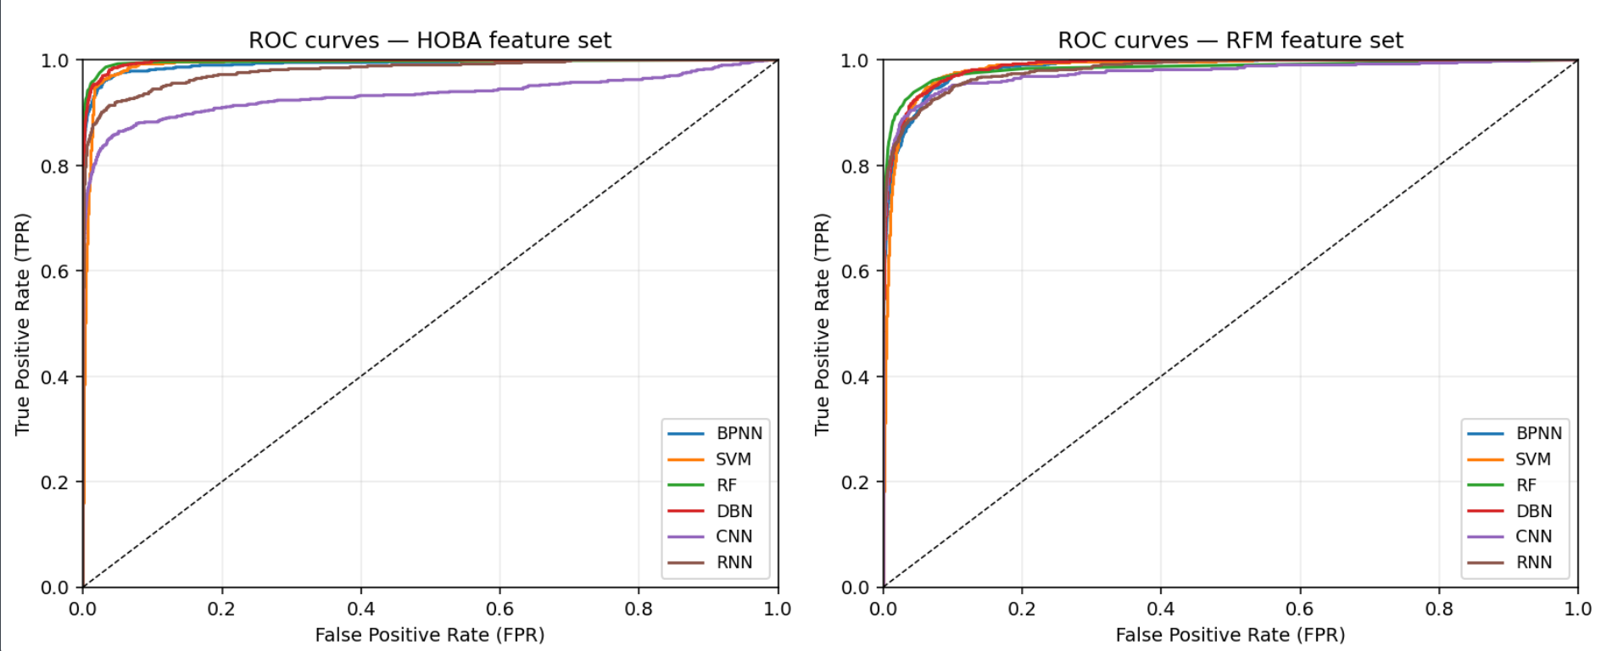
ROC curves

Slide 10
The Practical Test: Performance Under Low FPR
Recall under a 3% false-positive rate tolerance (Table 5b) — the metric the bank actually cares about
HOBA System
RFM Baseline
97%
89%
of fraud attempts blocked
at ≤ 3% false-positive rate
of fraud attempts blocked
at ≤ 3% false-positive rate
In plain terms
Out of every 100 fraud attempts, the HOBA system stops 97 — versus 89 using RFM. That is roughly two-thirds fewer fraud cases slipping through, with the same ceiling on how often legitimate customers are inconvenienced.

Slide 11
Catching More Fraud Without Annoying Real Customers
Higher recall and a controlled false-positive rate — achieved simultaneously
The Balance That Matters
Fewer than
More fraud caught AND fewer false alarms — at the same time. That is what makes the smarter approach genuinely superior rather than simply stricter.
3 in 100
genuine purchases
ever receive a second look
Why This Is Difficult to Achieve
so real customers are rarely interrupted
Any model can catch more fraud by flagging more transactions — but that raises false alarms. HOBA's richer features let the classifier discriminate rather than cast a wide net, keeping the false-positive rate within the business-acceptable 3% threshold while maximising recall.

Slide 12
Key Takeaways
01
Features matter as much as the model
Homogeneity-oriented behaviour analysis outperforms RFM for every single classifier tested — shallow and deep alike. The framework, not just the architecture, drives the improvement.
02
DBN + HOBA is the strongest practical detector
Pairing richer features with a deep belief network delivers the best overall AUC and the highest recall under the 3% false-positive constraint the business actually cares about.
03
The findings survive independently simulated data
The replication holds qualitatively even on freshly generated synthetic transactions — evidence that the paper's mechanism is sound, not an artefact of one particular dataset.
Zhang, Han, Xu & Wang (2021) · Information Sciences 557, pp. 302–316 · ECO 723

Slide 13
Thank you!

